Slide 1
Deep Learning Models for Single-Cell Spatial Transcriptomics Data
Carter Allen
11/30/2020

Slide 2
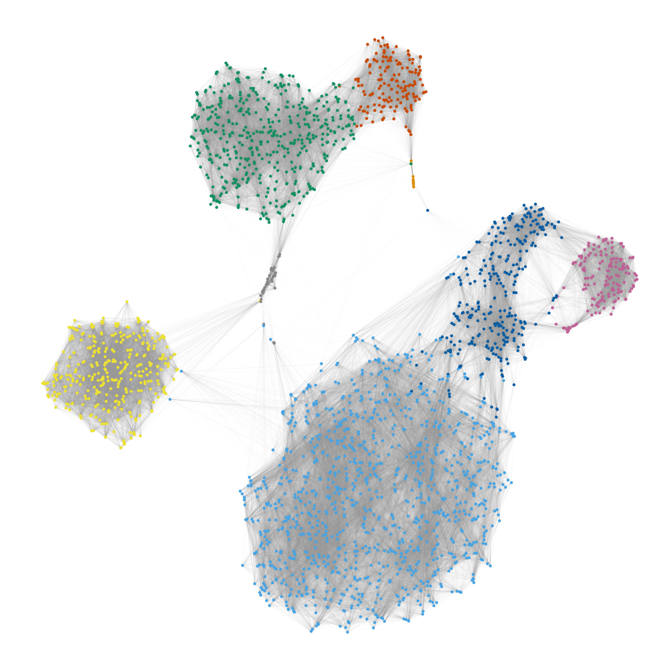
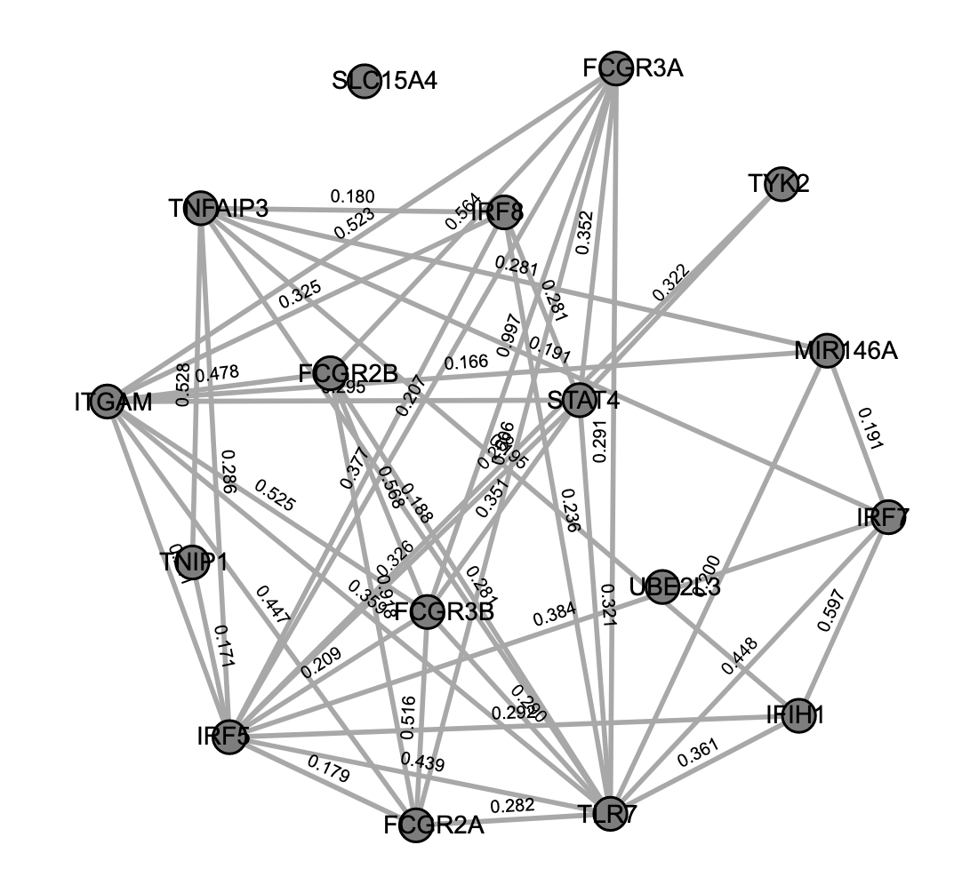
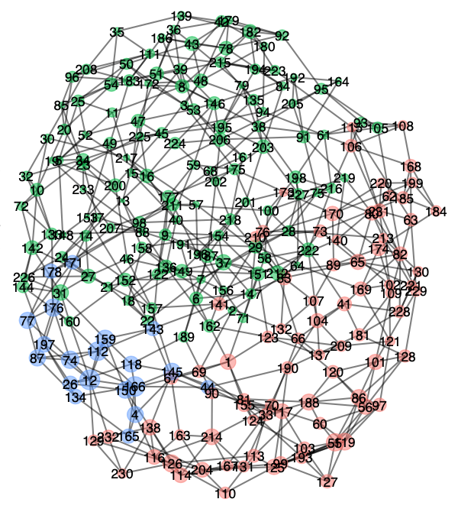
Introduction: Biological Network Data
Biological data often form networks: a collection of nodes and edges.
Examples include:
Cell to cell networks to find cell types in single-cell RNA-Seq data
Gene to gene networks to identify regulatory interactions
Organism to organism networks to identify sub-groups of interest
1
2
3

Slide 3
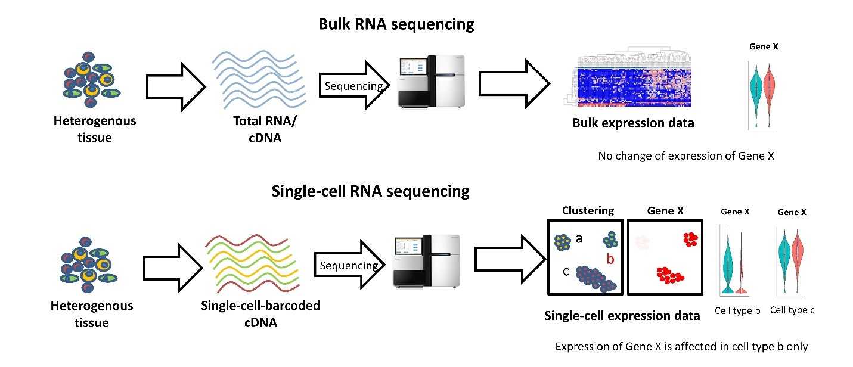
Background: Single cell RNA-Seq Data
Single cell RNA-Sequencing (scRNA-Seq) extends traditional bulk RNA-Seq technologies to the cellular level.
Recent Advances in Single-cell Genomics Techniques: Dmitry Velmeshev (2019)
3

Slide 4
Background: Single cell RNA-Seq Data
Traditional scRNA-Seq data analysis takes a cell by gene expression matrix as input and seeks to:
Infer cell types: Assign each cell to a cluster, which can be used to estimate the biological cell type of each cell.
Conduct differential expression (DE) analysis: Do certain genes exhibit different expression patterns across treatment conditions?
Predict cell-cell interaction: Can we predict which cells will interact to result in some biological hypothesis?
We will be primarily interested in cell type identification in this project.
4

Slide 5
Background: Clustering scRNA-Seq Data
Single cell experiments often involve a diverse population of cells.
Ex.) In a tissue sample from a melanoma tumor, we may have
MDSCs
CD8+ T-cells
Natural killer cells, etc…
A critical research goal is to infer the cell type of each cell in a tissue sample.
To identify cells, we:
Cluster cells based on similar gene expression patterns
Map clusters to cell types by comparing expression patterns to known databases
5

Slide 6
Introduction: Community Detection in Networks
Community detection is a common task in the statistical analysis of network data.
Community detection refers
to the task of assigning each
node (e.g., gene, cell,
organism, etc…) to a certain
community.
We expect communities to be
assortative, i.e., edges are
dense within communities but
sparse between communities
(Fortunado, Physics Reports 2019).

Slide 7
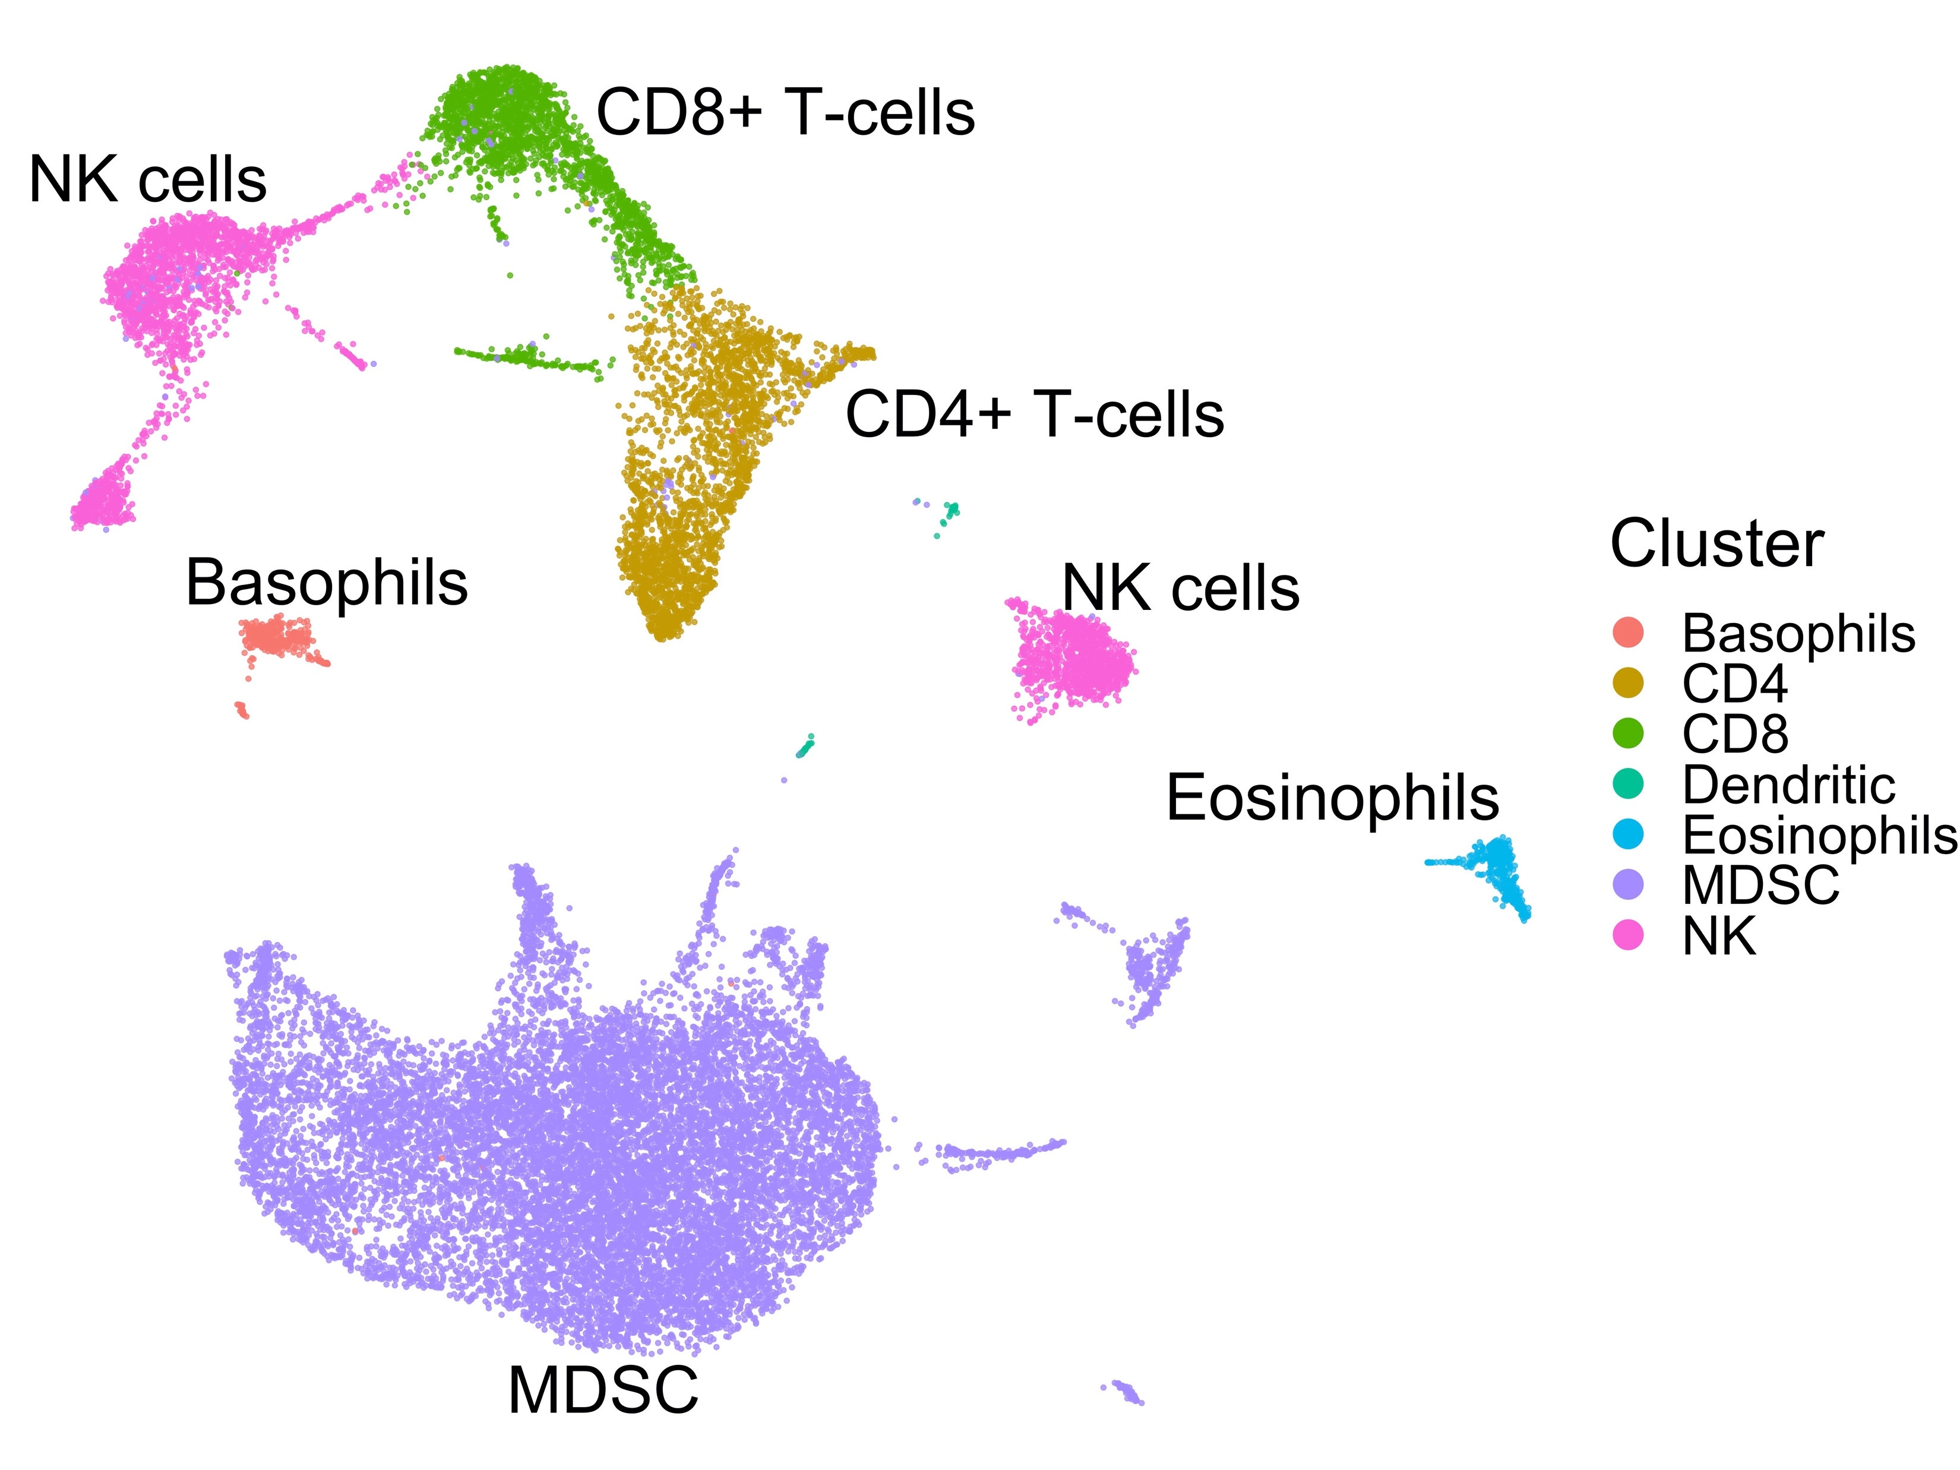
Background: Single cell RNA-Seq Data
7

Slide 8
Background: Clustering scRNA-Seq Data
A typical cell clustering workflow:
UMAP (Uniform Manifold Approximation): Reduces the dimensions of the cell by gene count matrix. PCA is also used by some workflows.
KNN (K-nearest neighbors): Converts rectangular data (rows and columns) to network data (nodes and edges).
Graph Clustering (community detection): Groups nodes (cells) together based on interconnectivity.
Gene
KNN
Cell
Graph
Clustering
UMAP
8

Slide 9
Background: scRNA-Seq Data
Key Point: Valid and robust scRNA-Seq data analysis relies upon accurate cell clustering.
Why? Cell clusters are used for:
Cell type identification: The gene markers for a certain cluster are compared to reference data bases to predict the type of cells in that cluster.
Differential Expression (DE) analysis: The cell clusters are used to define groups that we compare for differentially expressed genes.
Identification of treatment effects across multiple tissue samples.
9

Slide 10
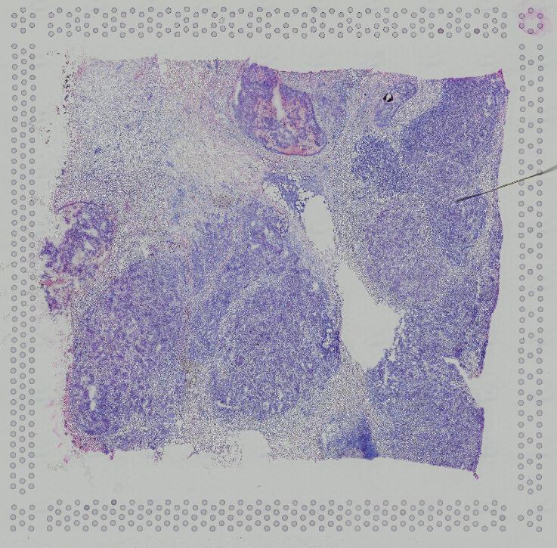
Background: Spatial Transcriptomics
Recent advances in experimental technology have made it possible to discern the location of each individual cell in a sample.
10

Slide 11
Background: RNA-Seq to (Spatial) scRNA-Seq
Methods are here
Biology is here
Bulk RNA-seq
scRNA-seq
Spatial scRNA-seq
2000
2020
Key Idea: Can we leverage recently-available spatial scRNA-seq data to
improve cell type identification and predict cell-cell interaction?
11

Slide 12
Background: Cell Clustering scRNA-Seq Workflow
The typical scRNA-seq cell clustering workflow:
Scale data and QC
Extract features and reduce dimensions of gene expression matrix
Construct cell-cell K-nearest neighbors networks based of similarity in gene expression features
Cluster cell-cell network using standard graph clustering algorithms
We will seek to improve Steps 2 & 4
12

Slide 13
Dimension Reduction Methods for Gene Expression
In this project, I will compare several methods for dimension reduction of gene expression data.
Principal Component Analysis (PCA)
Uniform Manifold Approximation and Projection (UMAP)
PCA + UMAP
PCA + Autoencoders
13

Slide 14
Autoencoders
This project seeks to integrate cell-level gene expression data with cell-level spatial location data.
Inputs:
A cell by gene matrix with gene expression counts
2-dimensional coordinated for the location of each cell
It is crucial to compute accurate low dimensional representations of the gene expression matrix.
Autoencoders may provide more flexibility over PCA, UMAP to reduce dimensions while preserving subtle patterns in gene expression data.
14

Slide 15
Autoencoders
To reduce dimensions with autoencoders, we will use a range of parameterizations:
AE 1: 3 layers (1 encoder, 1 bottleneck, 1 decoder)
AE 2: 5 layers (2 encoder, 1 bottleneck, 2 decoder)
AE 3: 7 layers (3 encoder, 1 bottleneck, 3 decoder)
Encoder/decoder layers will use Elu while bottleneck will use linear activation function.
15

Slide 16
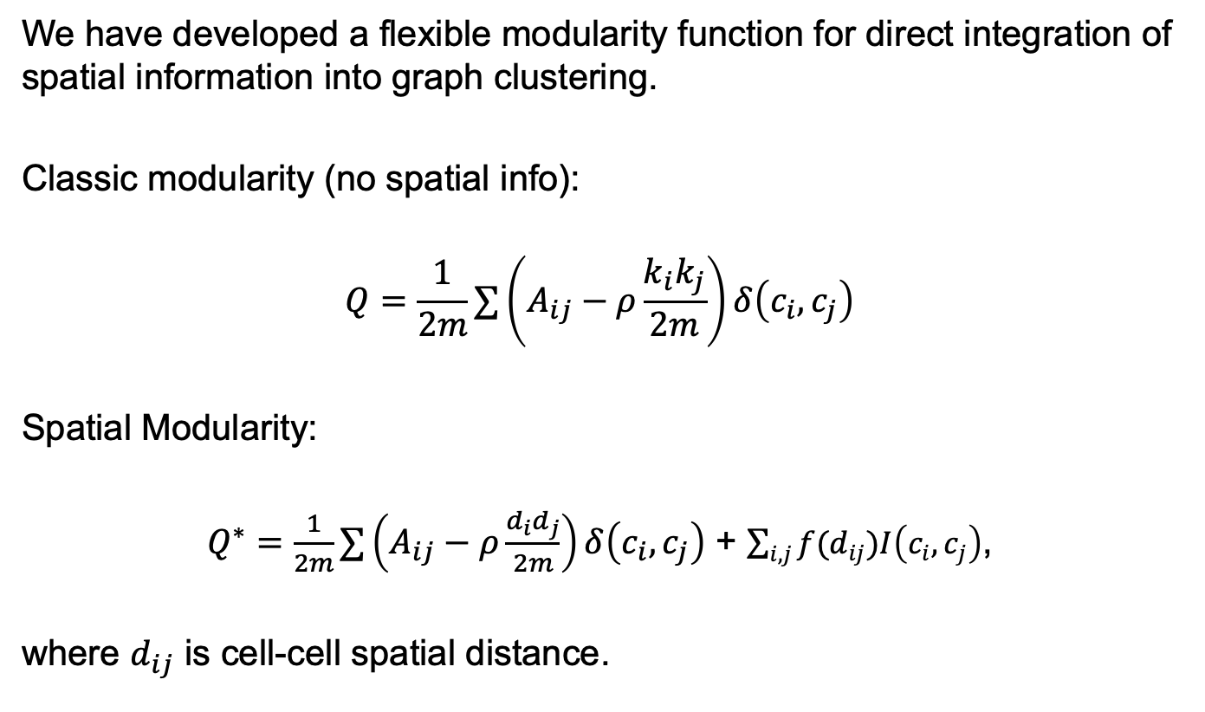
Spatial Modularity Function
We have developed a flexible modularity function for direct integration of spatial information into graph clustering.
Classic modularity (no spatial info):
$$Q=\frac{1}{2m}∑\left(A_{ij}−ρ\frac{k_{i}k_{j}}{2m}\right)δ\left(c_{i}, c_{j}\right)$$
Spatial Modularity:
$Q^{∗}=\frac{1}{2m}∑\left(A_{ij}−ρ\frac{d_{i}d_{j}}{2m}\right)δ\left(c_{i}, c_{j}\right)$ + $\sum_{i,j}{f(d_{ij})I\left(c_{i},c_{j}\right)}$,
where $d_{ij}$ is cell-cell spatial distance.
16

Slide 17
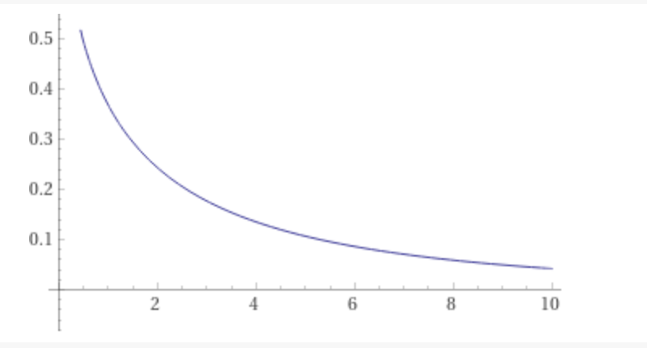
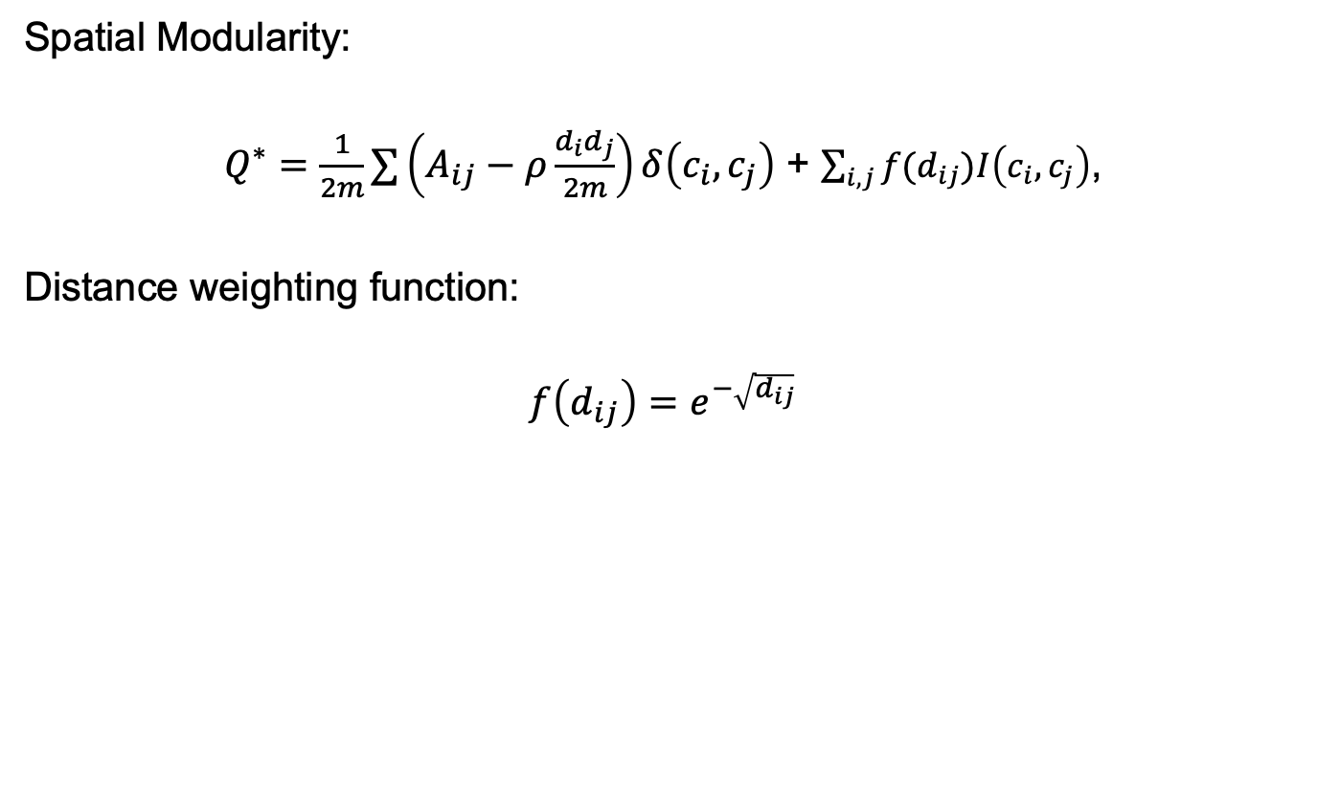
Spatial Modularity Function
Spatial Modularity:
$Q^{∗}=\frac{1}{2m}∑\left(A_{ij}−ρ\frac{d_{i}d_{j}}{2m}\right)δ\left(c_{i}, c_{j}\right)$ + $\sum_{i,j}{f(d_{ij})I\left(c_{i},c_{j}\right)}$,
Distance weighting function:
$$f\left(d_{ij}\right)=e^{−\sqrt{d_{ij}}}$$
17

Slide 18
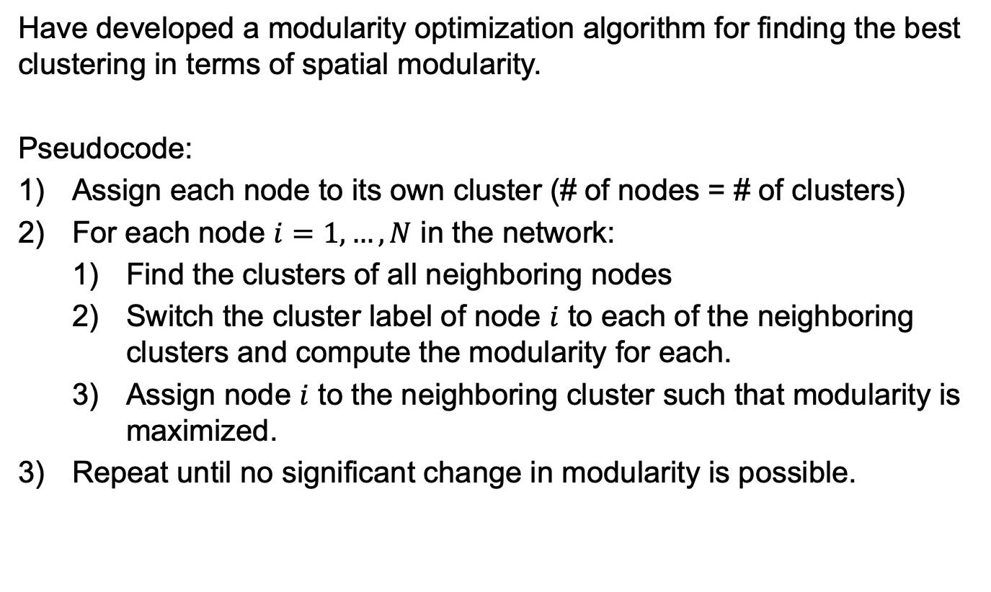
Modularity Optimizer
Have developed a modularity optimization algorithm for finding the best clustering in terms of spatial modularity.
Pseudocode:
Assign each node to its own cluster (# of nodes = # of clusters)
For each node $i=1,…, N$ in the network:
Find the clusters of all neighboring nodes
Switch the cluster label of node $i$ to each of the neighboring clusters and compute the modularity for each.
Assign node $i$ to the neighboring cluster such that modularity is maximized.
Repeat until no significant change in modularity is possible.
18

Slide 19
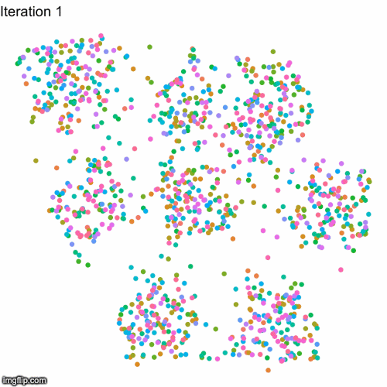
Modularity Optimizer: Visualization
19

Slide 20
Simulation Data
To evaluate the performance of this workflow, we need to use simulated spatial transcriptomics with known ground truth parameter values.
Adopt a 2-stage approach
Stage 1: Simulate gene expression values for each cell.
Stage 2: Simulate spatial cell locations.
Key Features:
Gene expression values of cell type marker genes are higher than those of non-marker genes.
Cells of the same cell type are spatially closer to one another on average than cells of different cell types.
20

Slide 21
Simulation Data
Number of cells (N) = 1,200 Number of total genes (G) = 800
Number of marker genes (M) = 400 Number of cell types (K) = 8
Each cell type has roughly 150 cells and roughly 50 marker genes.
For each cell type, corresponding marker genes are sampled from a signal distribution and non-marker genes from a noise distribution.
Signal distribution: ZINB(mean = 50)
Noise distribution: ZINB(mean = 25)
Cell locations are sampled from a bivariate normal distribution with cell-type specific means, such that cells of the same type are on average closer to one another.
21

Slide 22
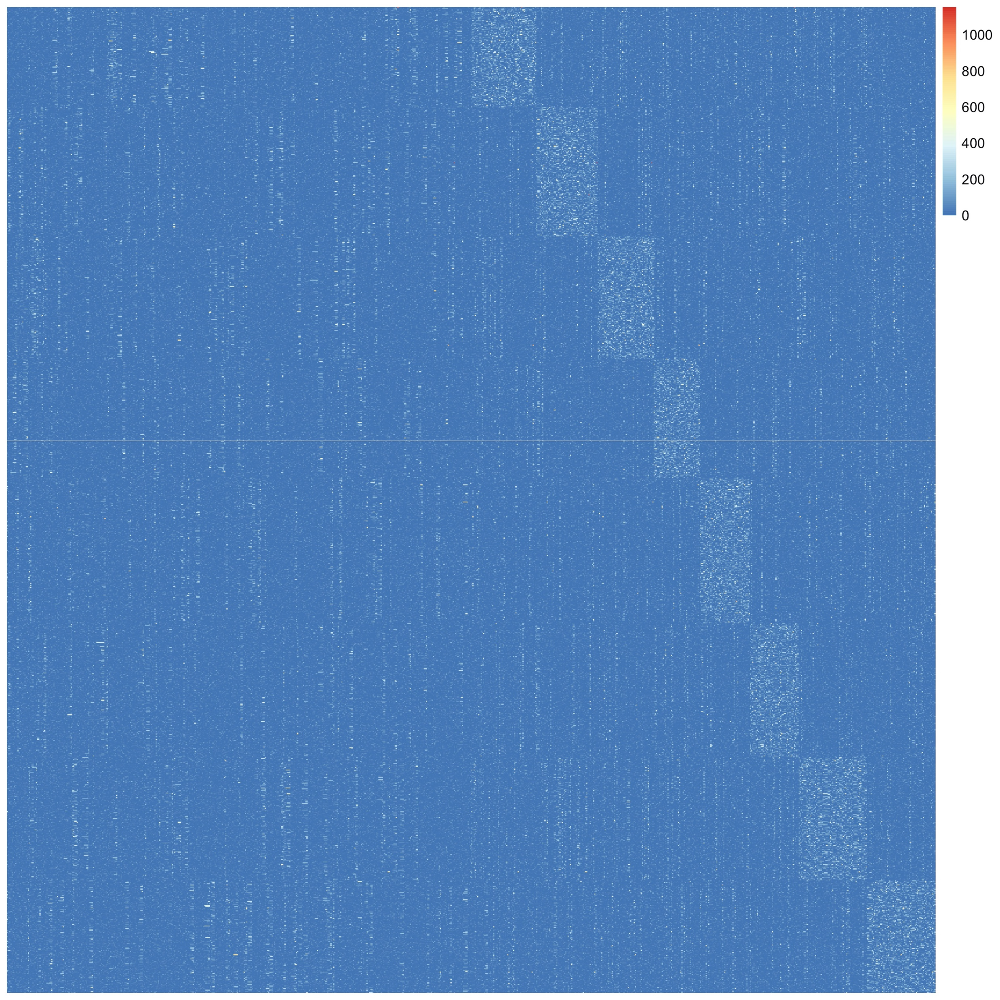
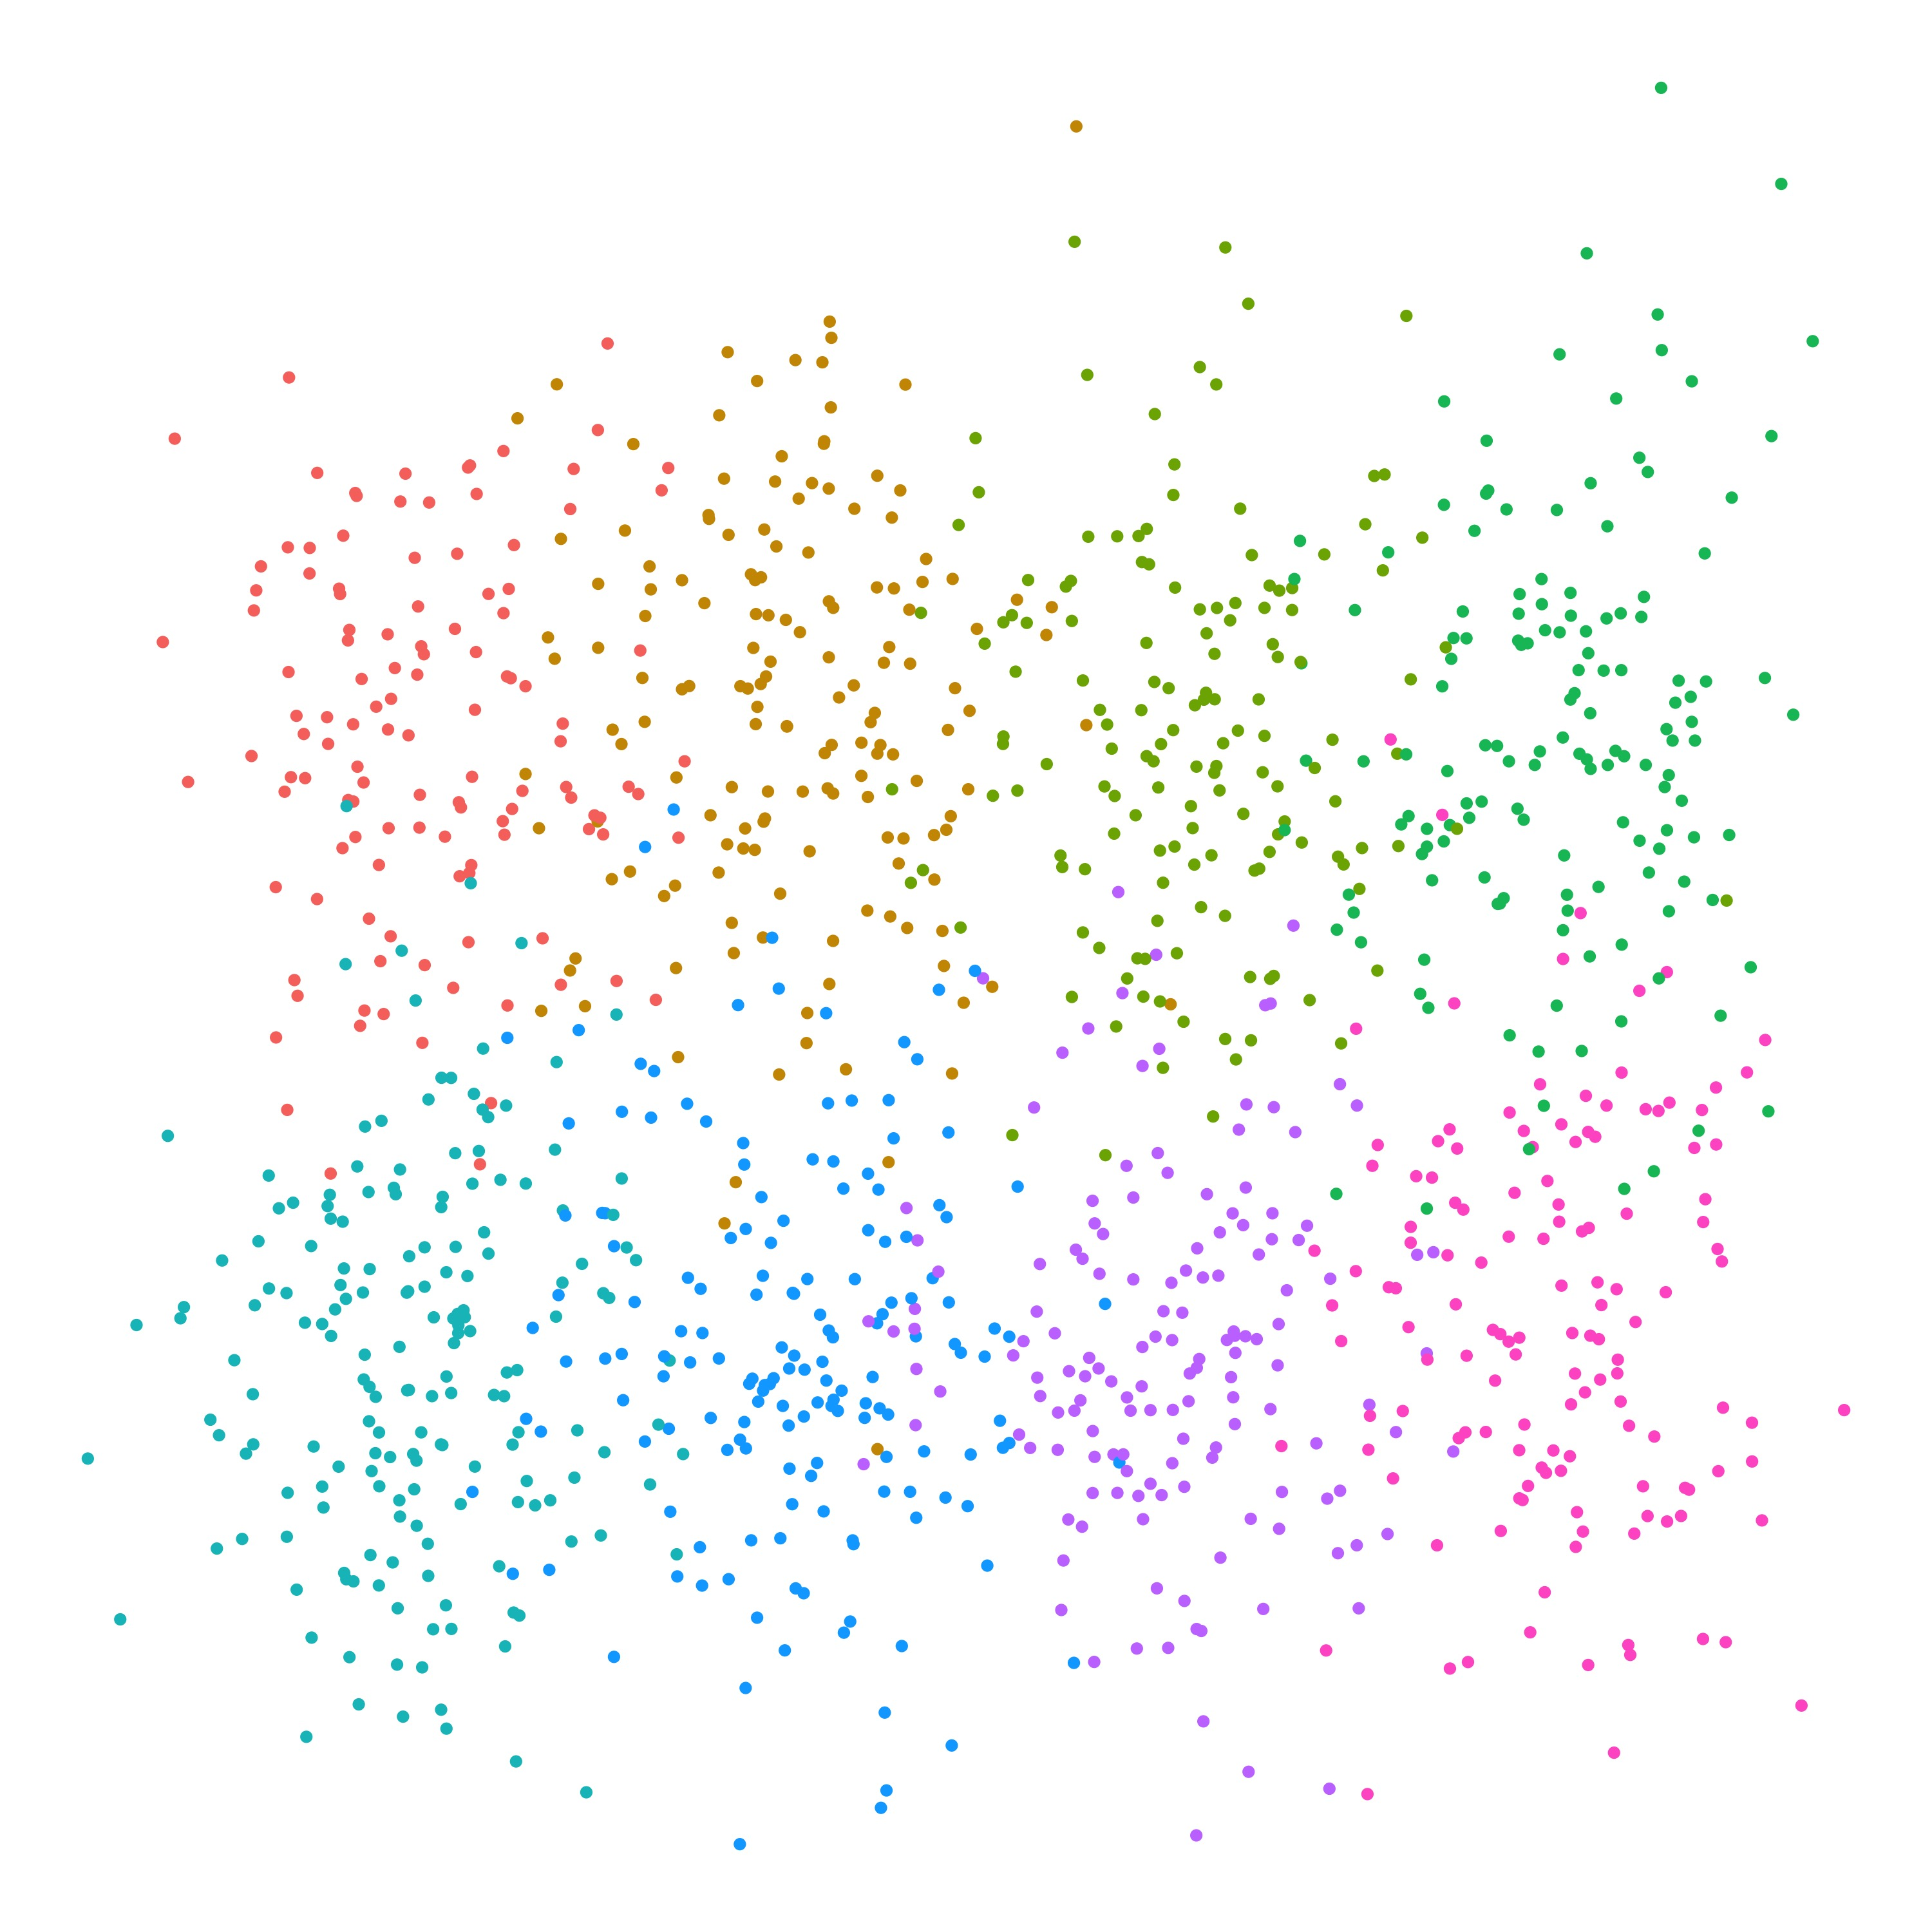
Simulation Data
Gene Expression
Spatial
22

Slide 23
Results
Clustering accuracy
Dimension Reduction | Non-spatial modularity | Spatial modularity
PCA (50) | 0.8150 | 0.8293
UMAP (50) | 0.8974 | 0.9725
PCA (50) + UMAP (2) | 0.8326 | 0.8671
PCA (50) + Autoencoder (3 layer) | 0.8991 | 0.9413
PCA (50) + Autoencoder (5 layer) | 0.9401 | 0.9739
PCA (50) + Autoencoder (7 layer) | 0.9398 | 0.9684
23

Slide 24
Conclusions
Considering spatial distance between cells in modularity function can help improve cell clustering accuracy in simulated data.
Autoencoders combined with PCA can provide improvements over classic dimension reduction methods such as UMAP/PCA.
Autoencoders require tuning, so optimal performance is not always achieved with default parameters.
Using UMAP alone with spatial information was able to achieve almost equal performance as autoencoders, but additional investigation is needed.
24

Slide 25
Thanks!
25

